Slide 1
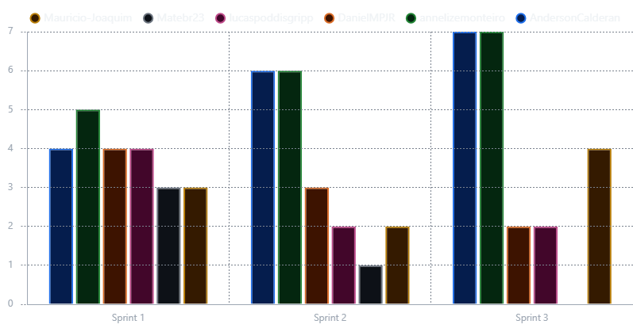
Sprint Burndown.
Count of items
Developed

